Slide 1
Dangers of street Racing
Student Name
Institution Affiliation

Slide 2
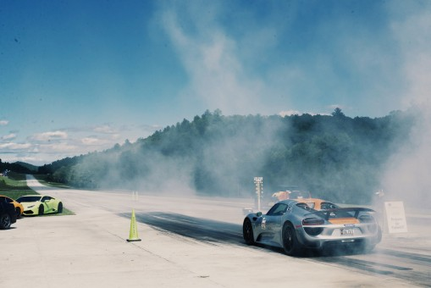
Noise Pollution
Due to high speed racing , residents in these streets are disturbed.
Social amenities such as schools and hospitals are also affected by pollution from speedy street racing.
Organizations within the streets cannot perform well due to distractions from the street races.

Slide 3
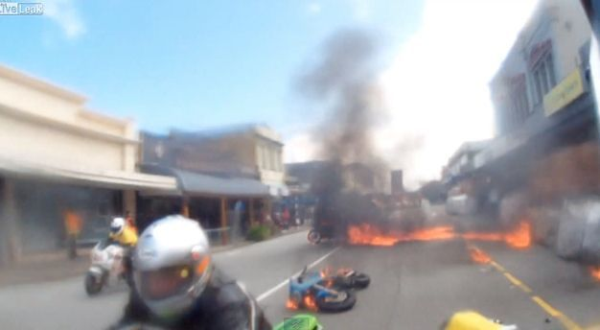
Increase in Accidents
Street racing causes poor interpretation of traffic signs.
Street racing creates a speedy environment hence drivers and pedestrians strive to come with the speed hence end up causing accidents.
To increase confidence while racing, some of the participants use drugs hence increasing risk of causing accident.

Slide 4
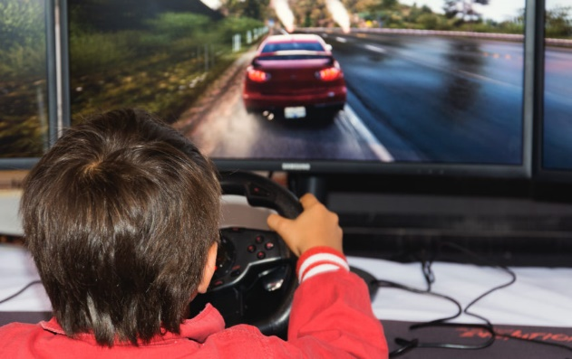
Destroying Society Morals
Street racing makes youths get more interested in sport hence taking everything to extremes posing danger to sports.
Idleness among the youths created since most of them spend much time playing online racing games.

